Slide 1
WHAT DID WE LEARN THIS TIME?
Why design our apps?
Stages of app design
Benefits of app design

Slide 2
THIS SECTION’S CHALLENGE!
Take my resources and design your own application, it can be something for fun, or something you’ve wanted to build for a while.
For bonus points, get feed back from at least one person on your idea – ways you can do this are:
Share it with the rest of the group on our Slack board and swap ideas and critique each others plans
Or ask a family member or a friend
Post it on Twitter, Reddit, Facebook etc.

Slide 3
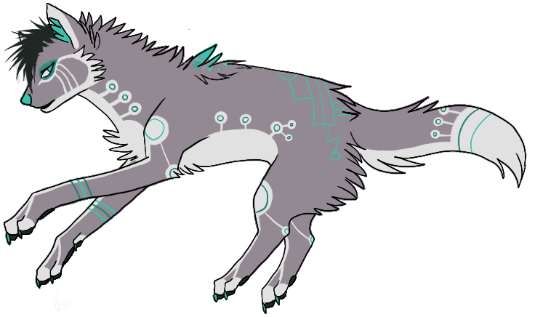
Need help?
Github:
http://www.github.com/webdevelopwolf/training
Twitter:
http://www.twitter.com/webdevelopwolf
Facebook:
http://www.facebook.com/webdevwolf

